Slide 1
Investigators: Hardik J. Pandya and Jagannathan Gopalakrishnan Team Members: V S N Sitaramgupta V, Gokul.AM, Sudarshan Jagannathan
Non-invasive Portable Ventilator and Respiratory using IOT

Slide 2
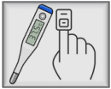
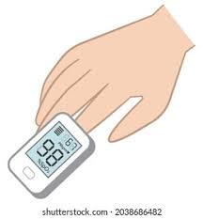
Overview of the Invention
The goal of this work is to develop an ecosystem approach to provide an emergency life-saving support to a patient.

Slide 3
Integrated Remote Patient Monitoring System
The integrated remote patient monitoring system contains several sub-modules to continuously monitor the other vital parameters of the patient.
Blood pressure: This module monitors the systolic and diastolic blood pressures of the patient in a real-time. The module uses a tubeless cuff, and pressure sensor. The device also provides the real-time pulse rate.
Respiratory rate: The TI ADS1298R measures real time respiratory rate of the patient. This module is helpful to adjust the ventilator parameters with respect to the respiratory rate.
12-lead ECG: The real-time ECG monitoring can help to understand the patient’s heart condition. This module also provides the heart rate of the patient.
Other vital parameter scan be monitored after integrating with wearable device (SVASTH watch):
Non-invasive diabetes
SpO₂ – oxygen saturation
Body temperature
Non-invasive hemoglobin

Slide 4
Claims
A non-invasive, portable ventilator system that can support up to two patients.
The ventilator system can be operated at 4 modes such as pressure control, volumetric control, time-based control, and assist control.
Ecosystem approach to provide an emergency life-saving support to the patient by utilizing IoT.
The system can communicate using Bluetooth and Wi-Fi.
Supports data-logging feature to SD card.
Multiple vital parameters of the patient can be monitored along with the ventilator support remotely.
A real-time patient’s condition can be visually monitored using motion sensing camera.
The ventilator system features to monitor and adjust the parameters remotely.
The system can be operated using 12 V charging socket.
The system can be integrated with the SVASTH GPS & GPRS location tracking APP for tracking the location of the ambulance.
The ventilator system is designed as a portable device for home-based patient care.
The system utilizes a portable air-compressor for automatic mixing of air and oxygen.

Slide 5
Claims
The ventilator provides auto alerts using buzzer, auto messages, and LED lights during emergency situations of patient’s health.
be integrated to a wearable device that monitors non-invasive glucosThe system provides an ECOSYSTEM approach in PATIENT CRITICAL CARE, as a life-saving initiative, that can be connected to ambulances, vans, 24x7 response centers and can provide tele-communication to the doctors, hospitals, and health experts.
The system can e, real-time heart rate, SpO2, body temperature and hemoglobin by integrating to a SVASTH watch.
The display unit of the device provides graphs of the vital parameters including respiratory rate, ECG, blood pressure, lung condition, and body temperature. The real-time results can be remotely monitored using cell phones, tabs and the master display screens.

Slide 6
Utility & Market Potential
Mobile Application: The IOT based integrated ventilator device provides a unique lifesaving critical care solution by installing them in all the ambulances with ventilator facilities. The effort is to provide the health support during the golden hour during medical emergency.
Market Potential:
Ambulances: 35000 Ambulances are in India, which can be fitted with ventilators for saving the critical patients due to road accidents, which will protect the patient’s life within the ‘GOLDEN HOUR’.
New ambulances with the ventilator facility can be initiated with the help of NGO, Trusts, etc. at every district headquarters/village as emergency services.
HOME CARE: The ventilator can be provided as critical care in every club house of apartments, public places, factories, construction sites, hotels, large public gatherings etc.
Hospitals: Smaller hospitals which cannot afford the high-cost ventilators can be provided with the ventilators, for critical Care.
Pandemic Solutions: The corona virus pandemic, has created demand for ventilators, due to the widespread of virus infection and positivity.

Slide 7
Novelty
It is a portable system which can be integrated with other biomedical devices that measures physiological parameters of the body
The Ventilator device is monitored and controlled remotely, based on the Patient condition.
Ventilator works on an IOT platform, and integrates with 12 lead electrocardiogram (ECG), respiration monitoring, digital stethoscope, and blood pressure device
The system supports both USB and IOT connectivity
Capability to probe a lot of different control algorithms and configurations
ECO-SYSTEM approach for enhanced LIFE SAVING EFFORT
Ability to modify the software according to the user requirements
The invention provides for simultaneous support to two patients using shared multiple sensors.

Slide 8
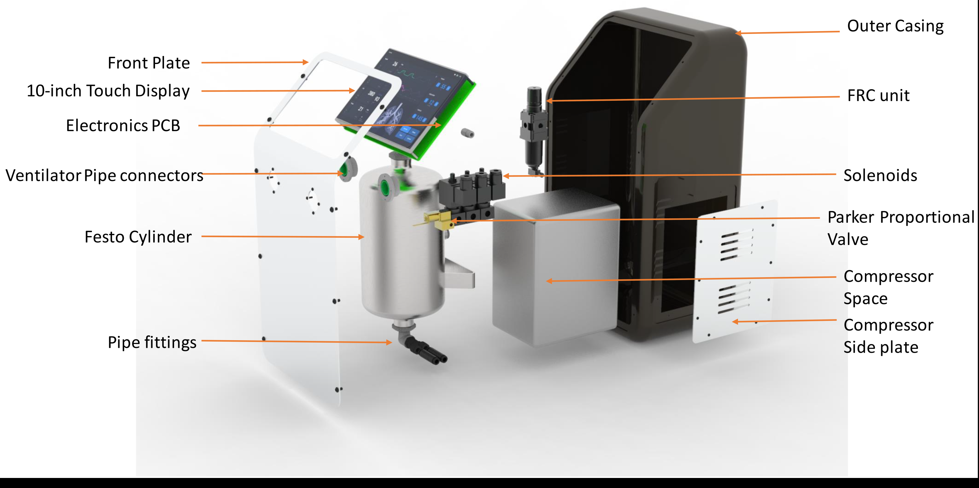
Blown-Up View of the Casing

Slide 9
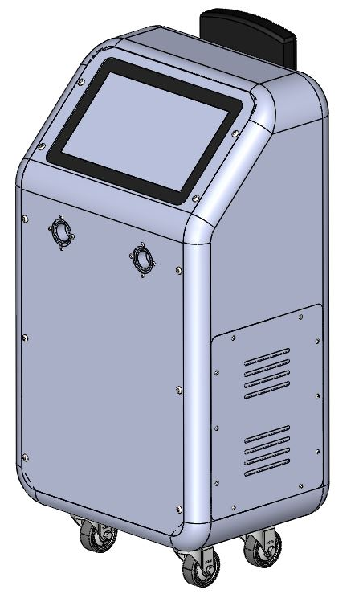
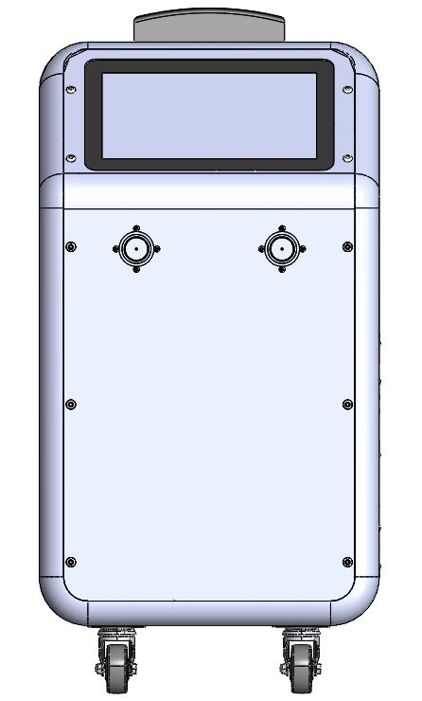
Ventilator CAD Design
Isometric View
Front View
Side View

Slide 10
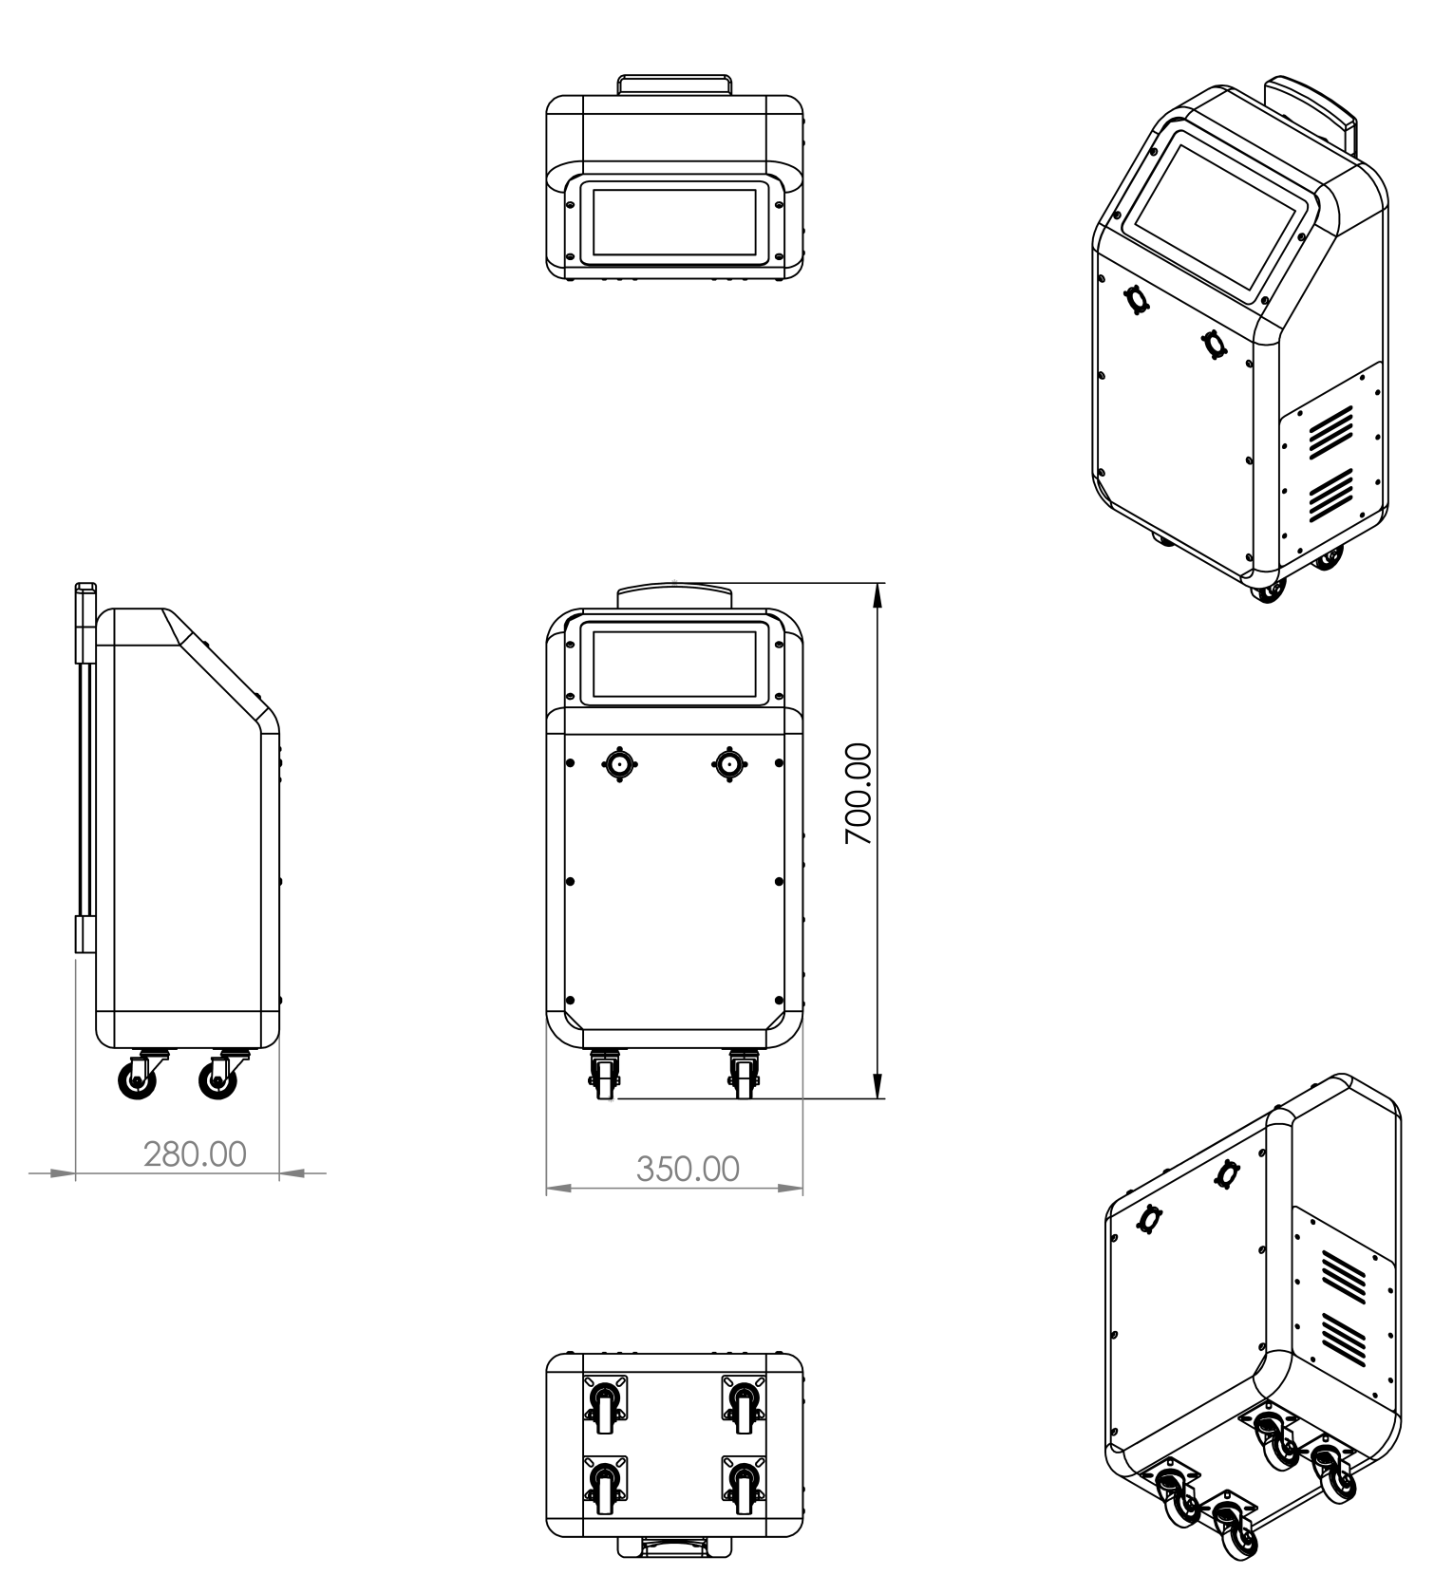
Engineering Drawings

Slide 11
Thank you

